Slide 1
My best memory

Slide 2


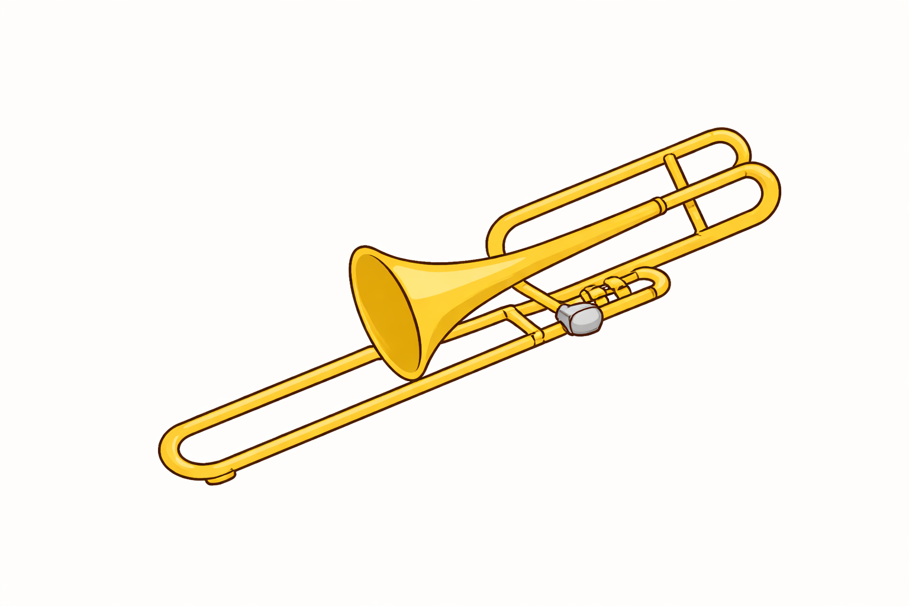
Brass band
clab

